Slide 1
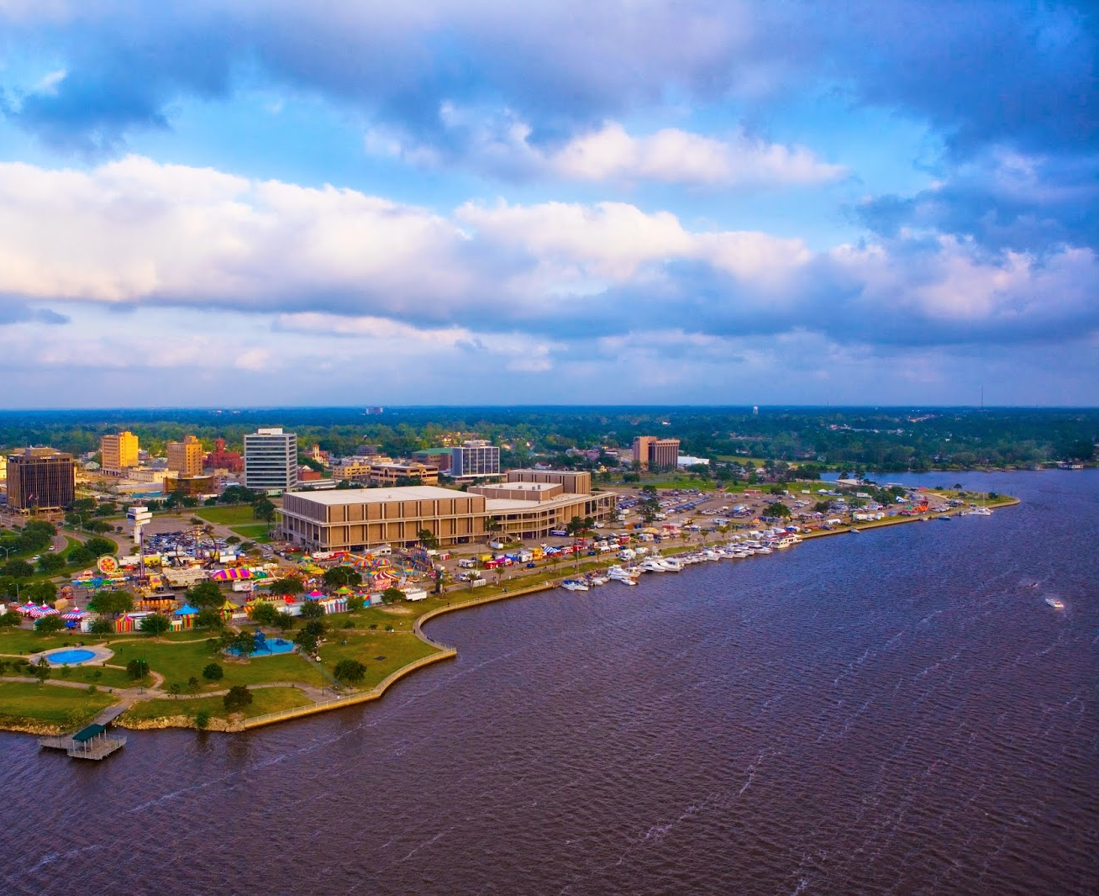
City of Lake Charles
Planning & Zoning Services
Updated 1/8/2024

Slide 2
Land Use and Zoning Map Updates
The proposed changes included in this document result from a comprehensive effort to study the City’s existing land use policies and zoning maps and suggest changes to accommodate future growth within the City.
This exhaustive effort has included feedback from citizens through a series of stakeholder meetings and neighborhood meetings held throughout the City.
The majority of zoning changes in the maps that follow represent “up zoning,” allowing for more uses as a permitted land use or approval through the conditional use review process.
These recommended changes are largely the result of changes in roadway classifications (two lane to four or five-lane corridors) and general changes in land use of a specific area.

Slide 3
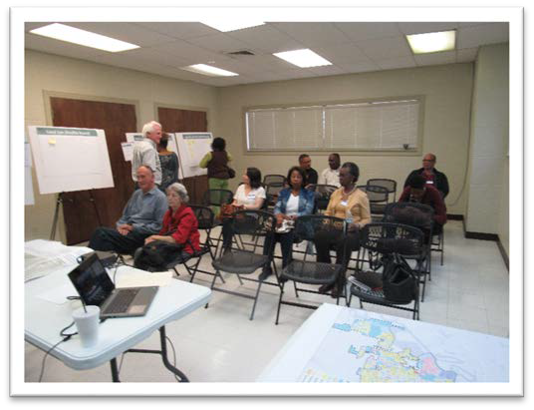
Work accomplished to date
Meetings:
Stakeholders
City Council Members
Planning and Zoning Commissioners
Historic Preservation Commissioners
Residents and the general public
Engineers and design professionals
Realtors and brokers
Contractors
Business leaders
Neighborhood Meetings Across the City
MLK Center – Tuesday, March 12, 2019
Prien Lake Park – Wednesday, March 13, 2019
Oak Park Middle School – Thursday, March 14, 2019
JD Clifton Rec – December 4, 2023
Hilcrest Park Rec – December 5, 2023
College Oaks Rec – December 7, 2023

Slide 4
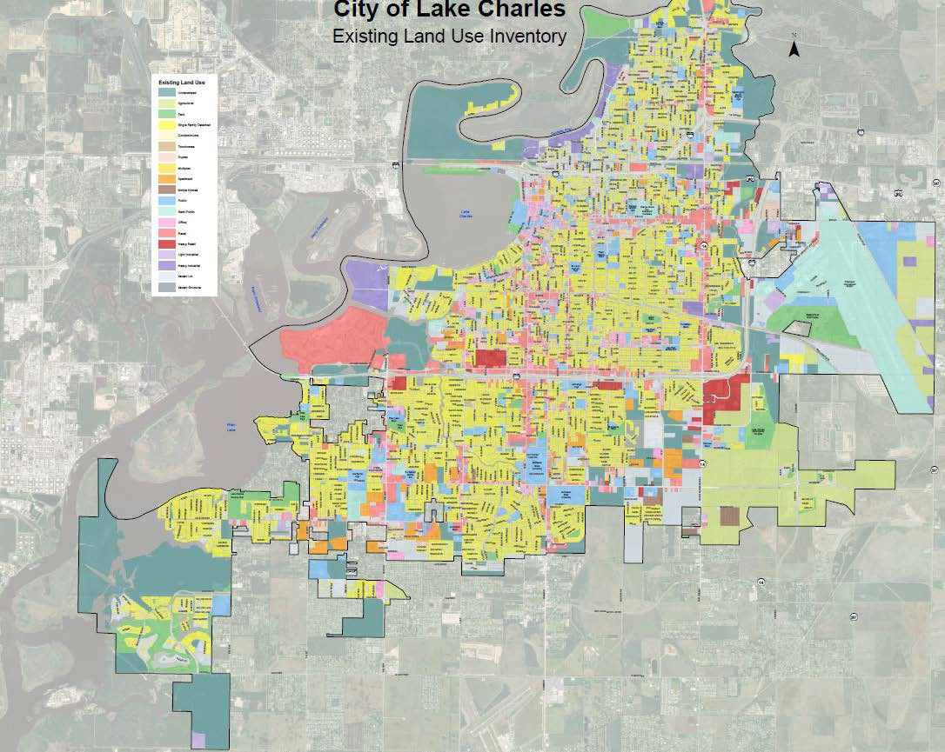
Zoning Classifications
Most Restrictive to Least Restrictive
Residential
Neighborhood
Mixed Use
Business
Light Manufacturing
Industrial
Most
Restrictive
Least Restrictive

Slide 5
Permitted Uses by Type
Residential Zoning District:
Single-family detached dwellings, provided it does not exceed seven dwelling units per acre
Accessory uses
Home occupations
Public Uses (Schools, Libraries, etc.)
Agriculture
Accessory uses to the residential use

Slide 6
Permitted Uses by Type
Neighborhood Zoning District:
Single-family attached and detached dwellings, provided it does not exceed 10 dwelling units per acre.
Accessory uses
Home occupations
Public uses (schools, libraries, etc.)
Churches
Agriculture
**Any non-residential use requires a Major Conditional Use Review Process**

Slide 7
Permitted Uses by Type
Mixed Use Zoning District:
Single-family attached and detached dwellings, provided it does not exceed 12 dwelling units per acre
Accessory uses
Home occupations
Public uses (schools, libraries, etc.)
Churches
Agriculture
Home Businesses
Bed and Breakfast Facilities
**Any non-residential use requires a Major & MinorConditional Use Review Process**

Slide 8
Permitted Uses by Type
Business Zoning District:
Indoor general retail and service establishments
Offices and financial institutions
Restaurants and entertainment
Institutional uses
Hotels and motels
Public uses (schools, libraries, etc.)
Kennels
Recreational facilities
Churches
Agriculture
Day care centers, provided the facility is fenced or enclosed so that children cannot leave the premises without adult supervision and the premises is buffered in accordance with Section 24-5-209
Drive-in or drive-through facilities for the sale of food or beverages, provided that:
-The facility is installed on a permanent foundation
-The facility and use does not involve more than 2,500 square feet of total gross floor area
-The parcel of land on which the use is located fronts on a collector or arterial street
-The use is buffered in accordance with Section 24-5-209; and
-Parking and stacking for vehicles are provided in accordance with Section 24-5-208
Outdoor retail sales and service establishments when the facility is buffered and landscaped in accordance with Sections 24-5-209 and 24-5-210, and the floor area ratio does not exceed 0.5, excluding tow yards or wrecker companies and storage of vehicles related thereto
Bed and Breakfast facilities
**All other uses not listed above requires a Conditional Use review and approval**

Slide 9
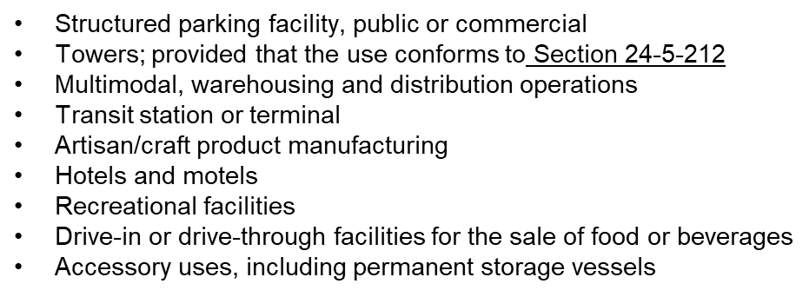
Permitted Uses by Type
Light Manufacturing Zoning District:
Indoor/outdoor retail and service establishments
Indoor woodworking, including cabinetmakers
and furniture manufacturing
Welding shops
Restaurants and entertainment
Agriculture
Repair of scientific or professional instruments
Building, heating, plumbing, or electrical warehousing
Printing, publishing, and lithography
Exterminators; janitorial and building maintenance warehouses
Coatings, clothing or textile manufacturing
Financial institutions and offices
Public uses (schools, libraries, etc.)

Slide 10
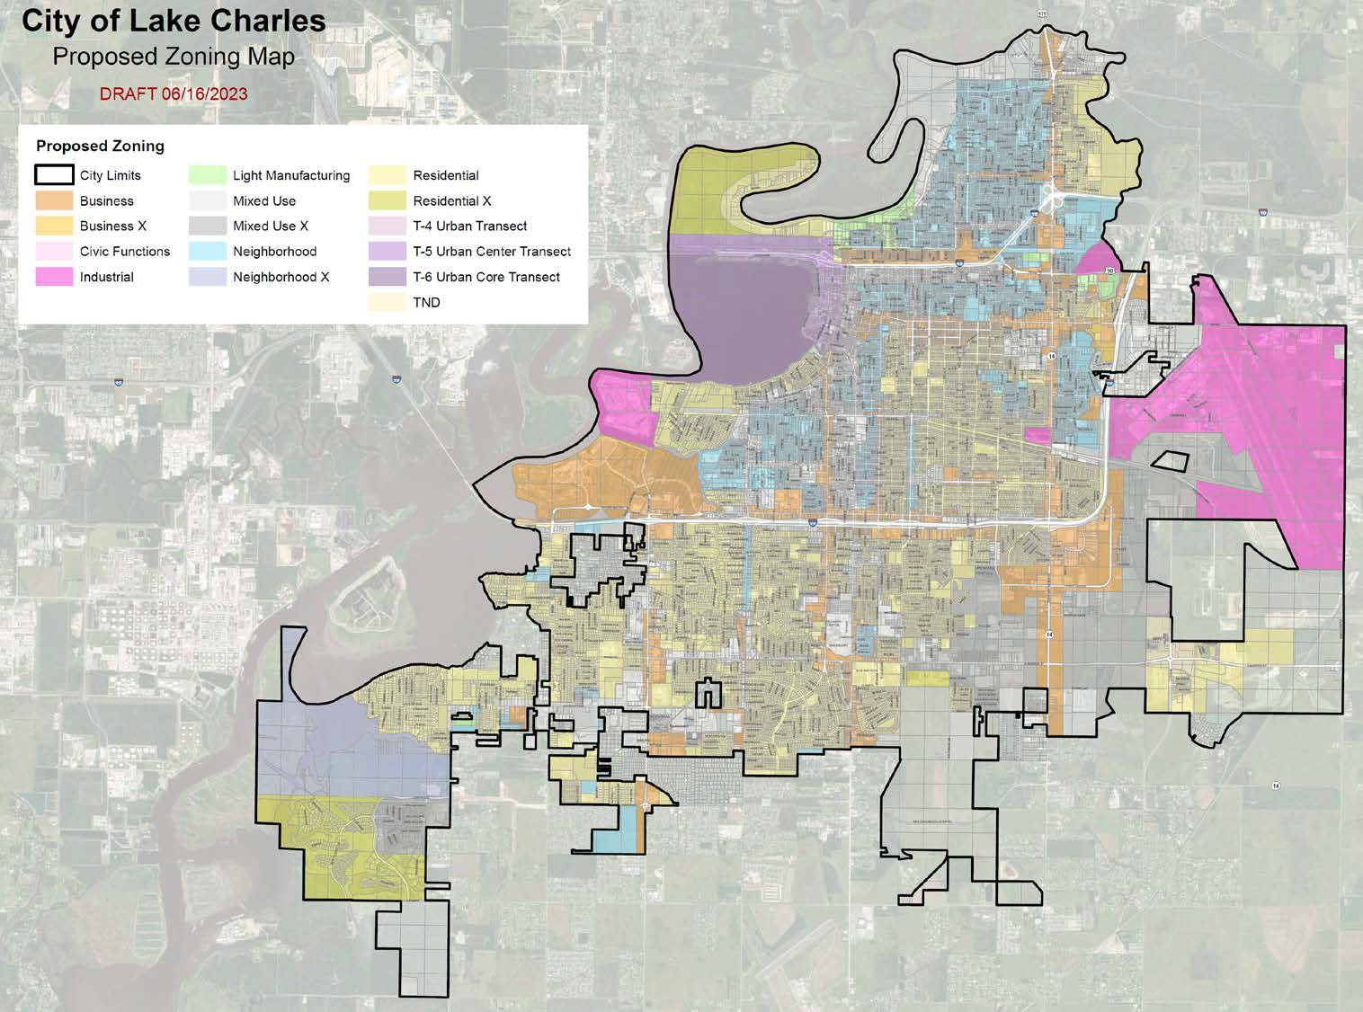
Preliminary Overview of Additional Proposed Zone Change Locations (NEW)
Location of proposed zoning change

Slide 11
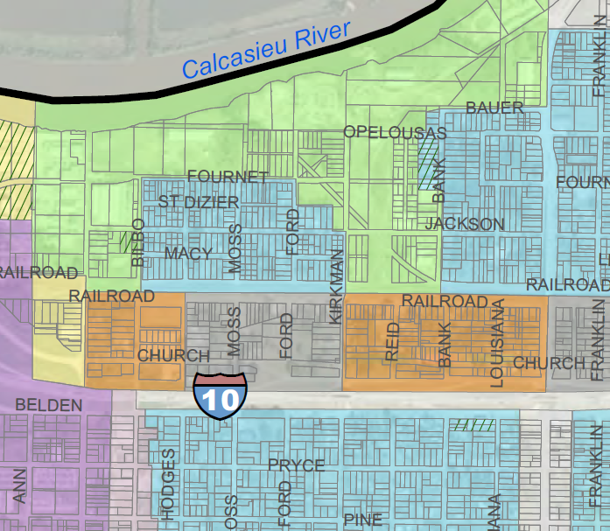
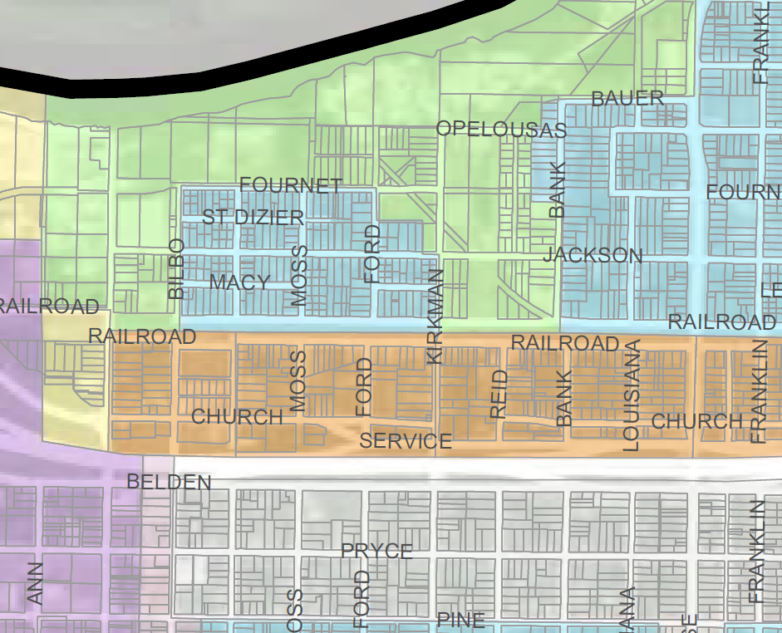
District A
Location of proposed zoning change
Proposed - Business
Current – Mixed Use

Slide 12
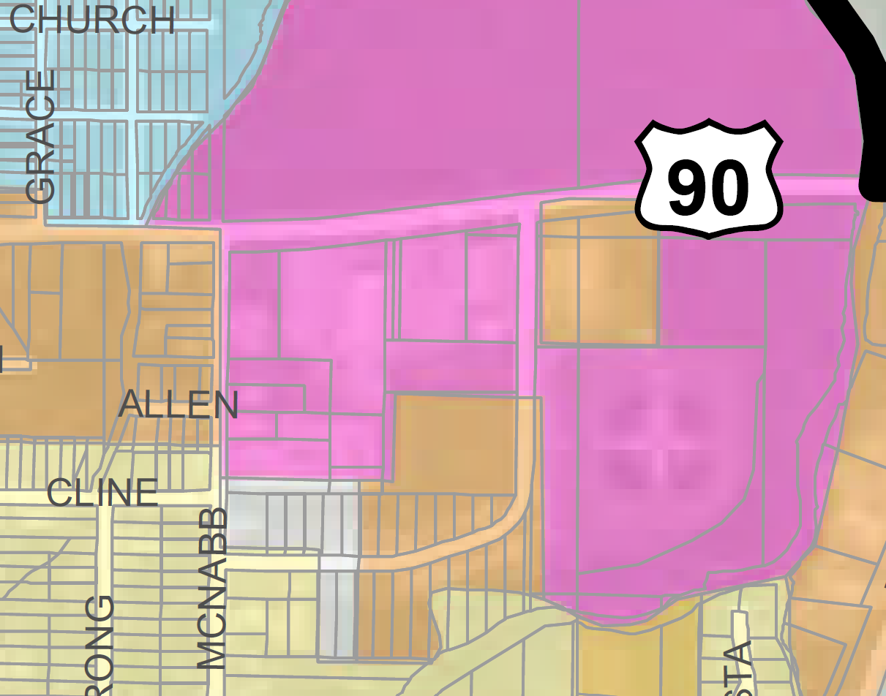
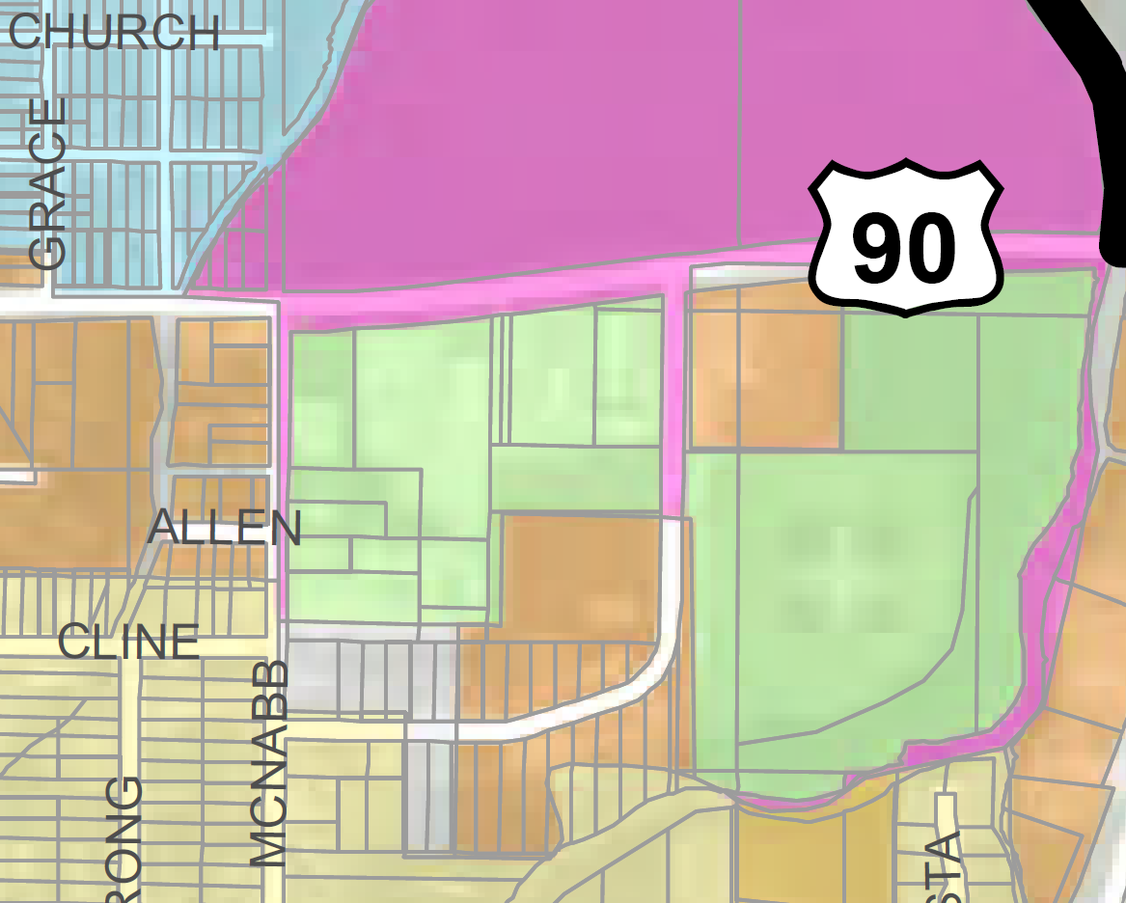
District A
Location of proposed zoning change
Current – Industrial
Proposed – Light Manufacturing

Slide 13
Location of proposed zoning change
District A
Proposed – Mixed Use
Current – Neighborhood

Slide 14
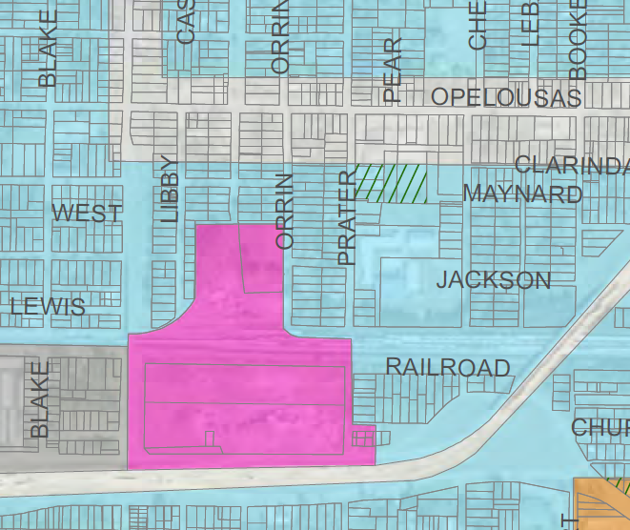
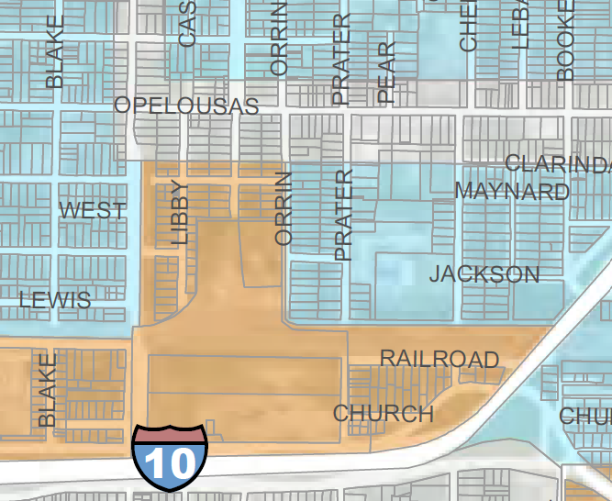
Districts A & B
Location of proposed zoning change
Proposed – Business
Current – Industrial and Neighborhood

Slide 15
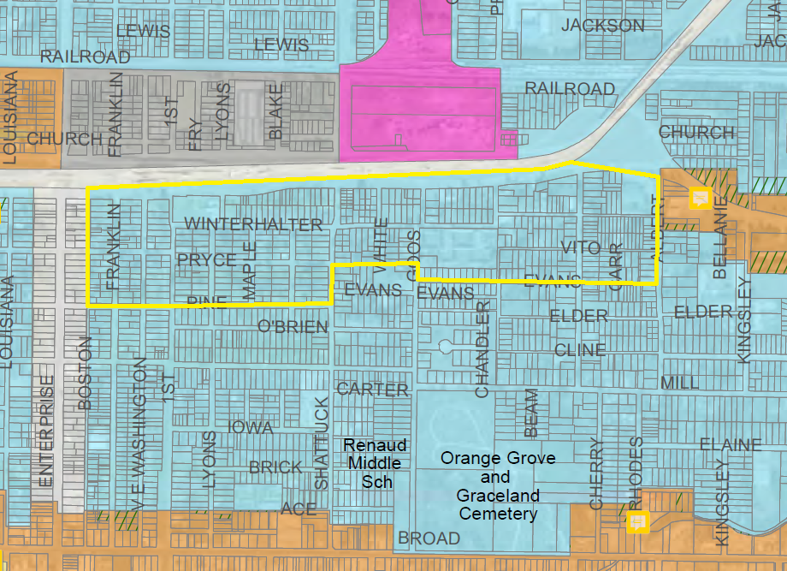
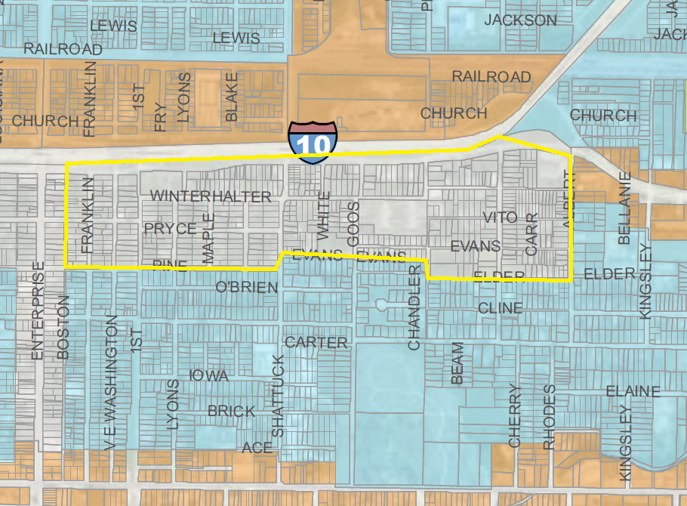
Location of proposed zoning change
District B
Proposed – Mixed Use
Current – Neighborhood

Slide 16
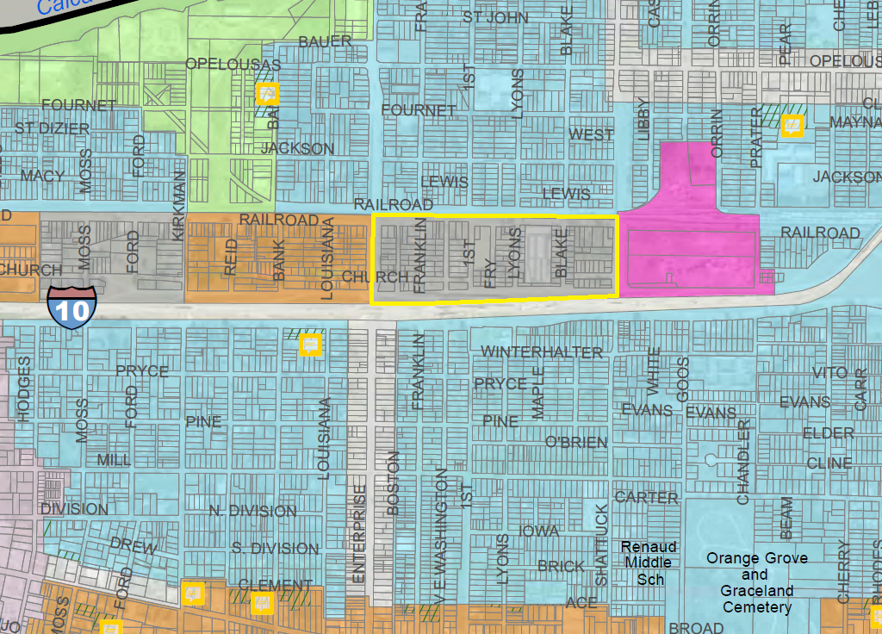
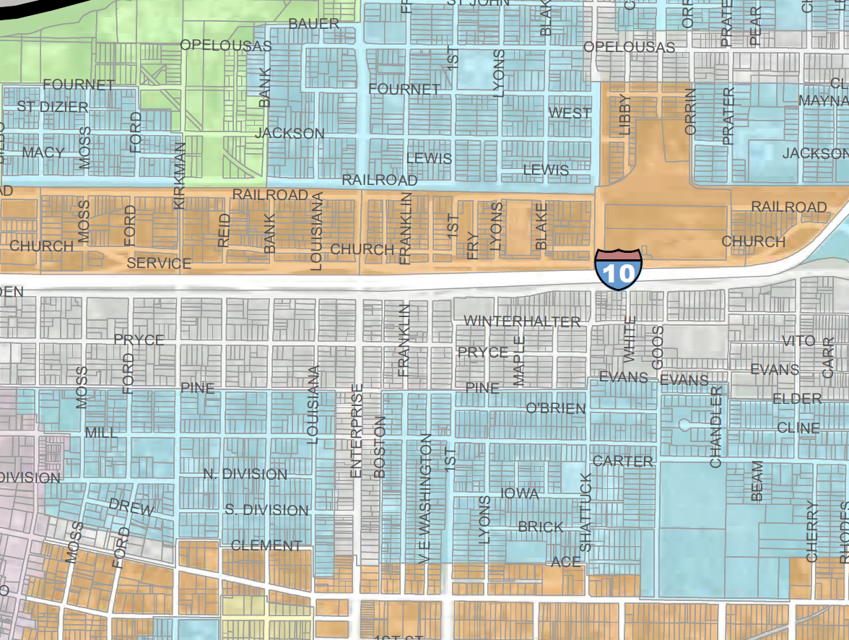
District B
Location of proposed zoning change
Proposed – Business
Current – Mixed Use

Slide 17
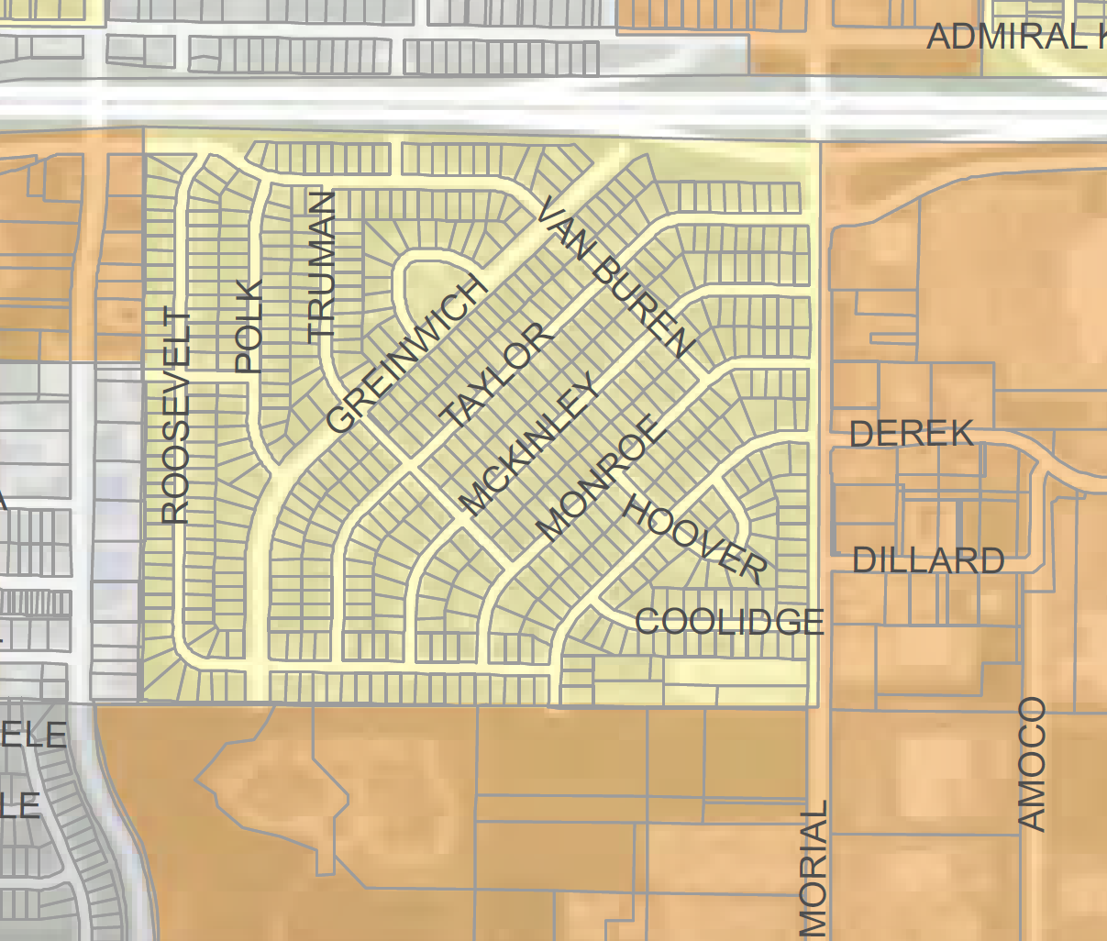
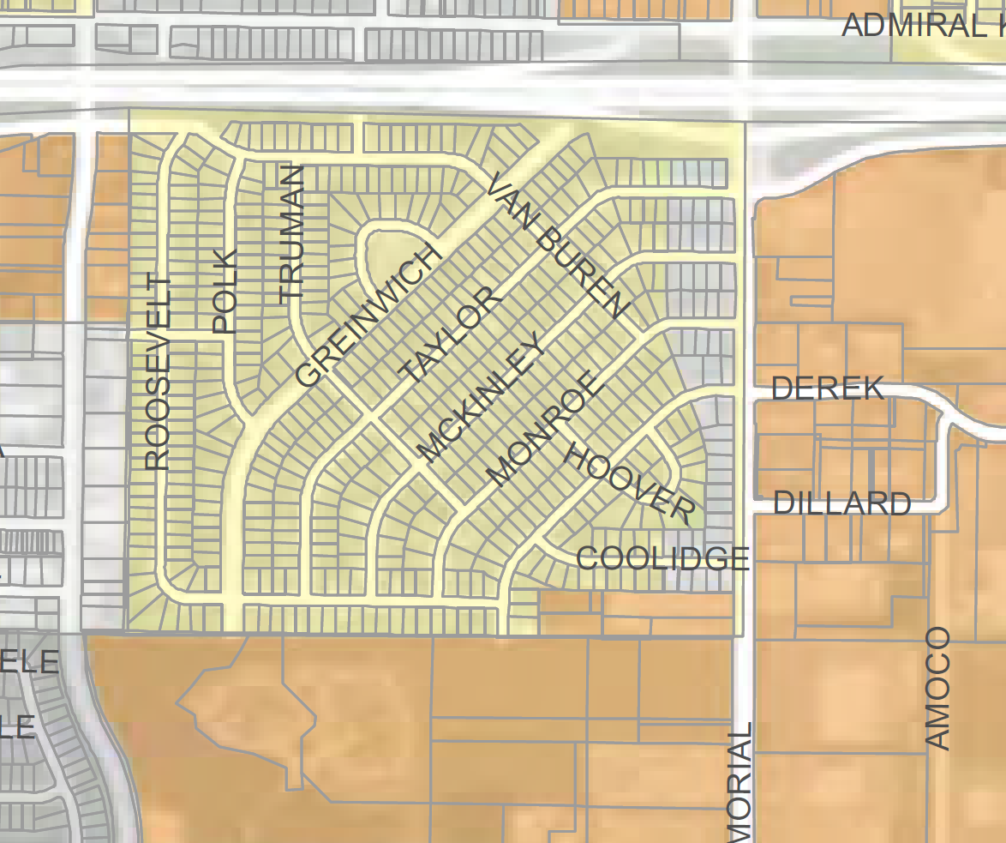
District C
Location of proposed zoning change
Current – Residential
Proposed – Mixed Use and Business

Slide 18
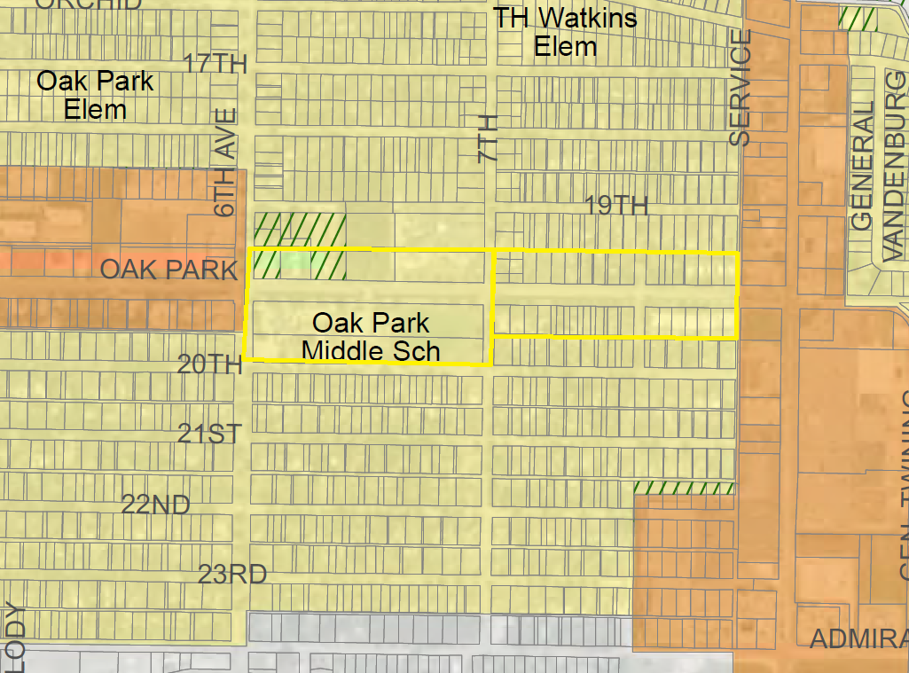
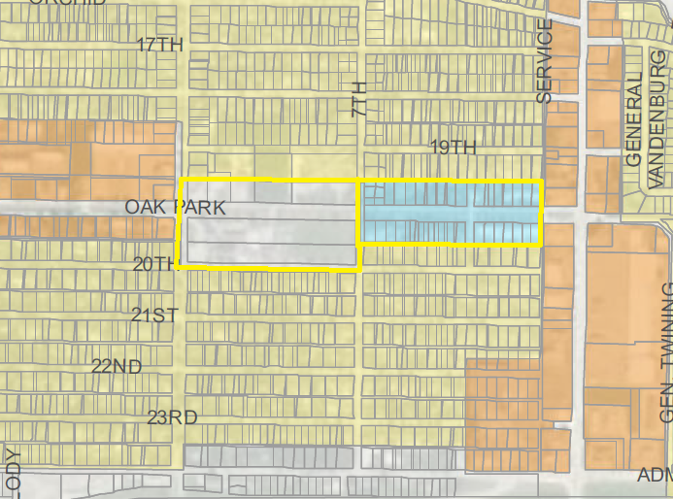
District C
Location of proposed zoning change
Current – Residential
Proposed – Mixed Use & Neighborhood

Slide 19
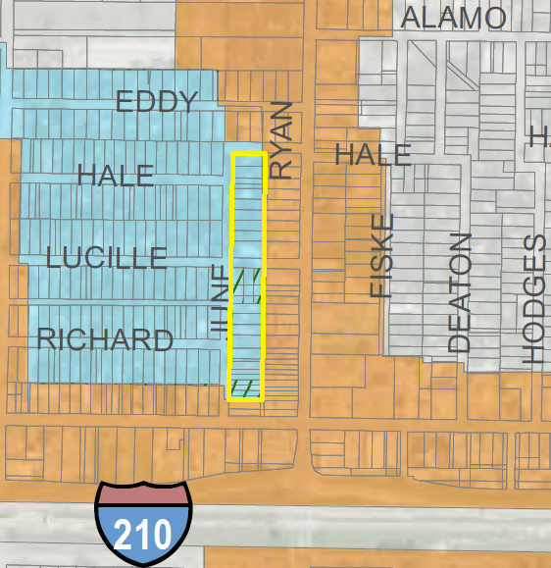
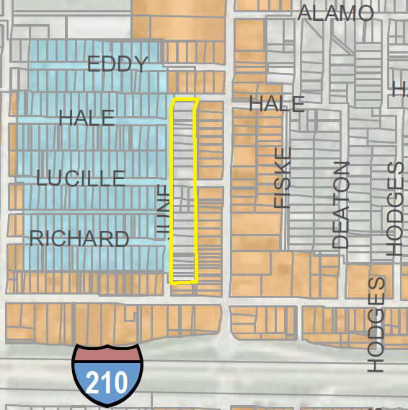
District D
Location of proposed zoning change
Current – Neighborhood
Proposed – Mixed Use

Slide 20
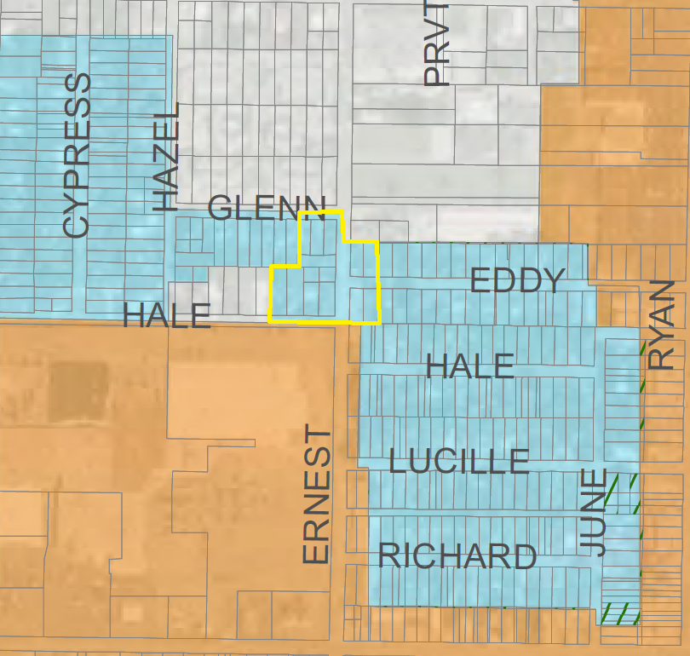
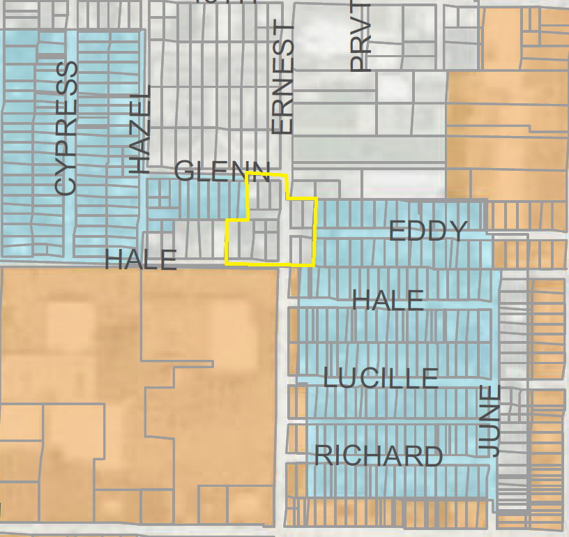
District D
Location of proposed zoning change
Current – Neighborhood
Proposed – Mixed Use

Slide 21
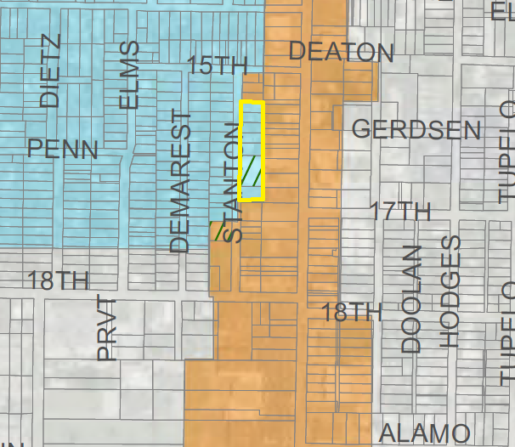
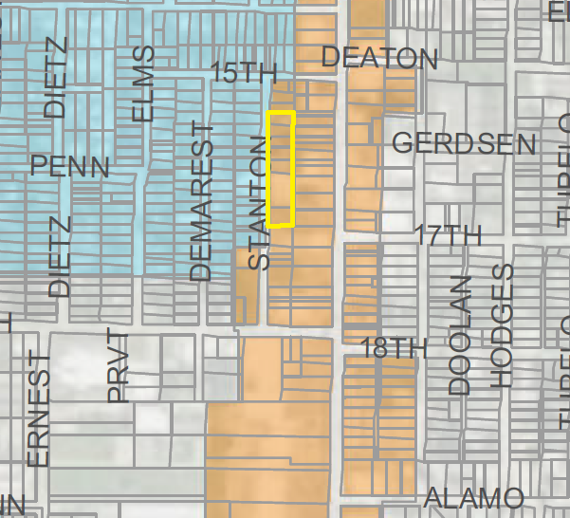
District D
Location of proposed zoning change
Current – Neighborhood
Proposed – Mixed Use

Slide 22
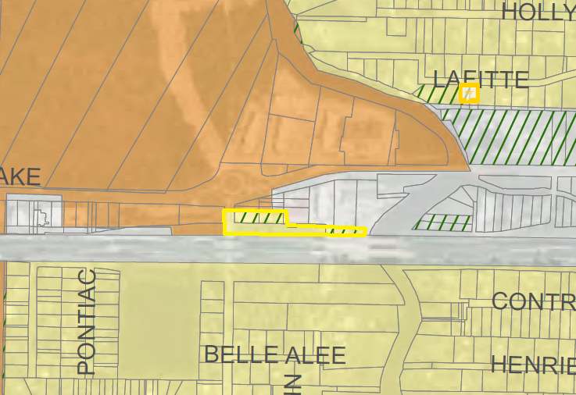
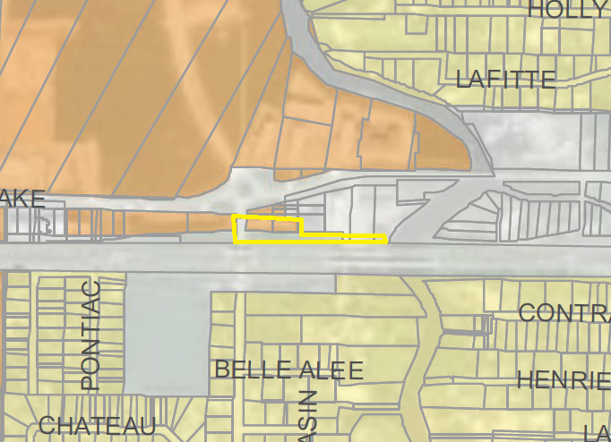
Location of proposed zoning change
District D
Current – Neighborhood
Proposed – Mixed Use

Slide 23
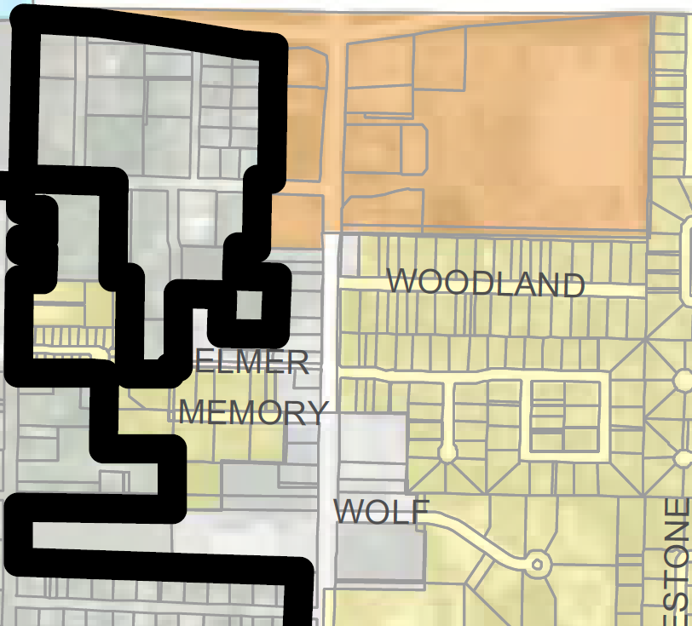
District E
Location of proposed zoning change
Current – Residential
Proposed – Mixed Use
NELSON
NELSON

Slide 24
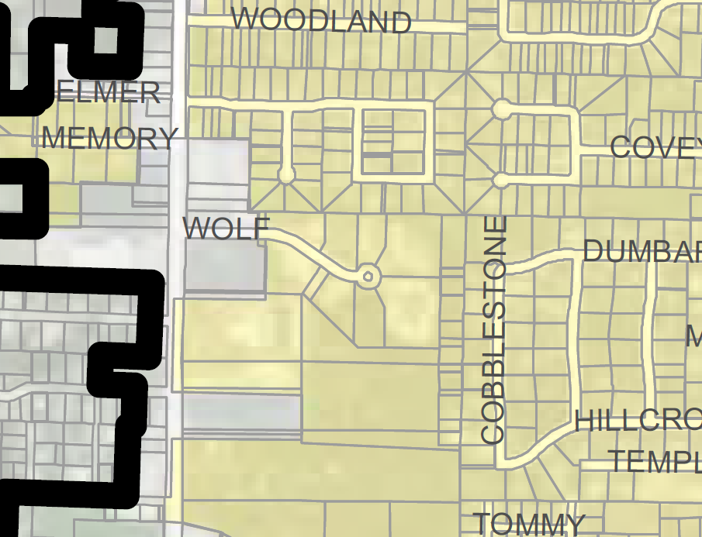
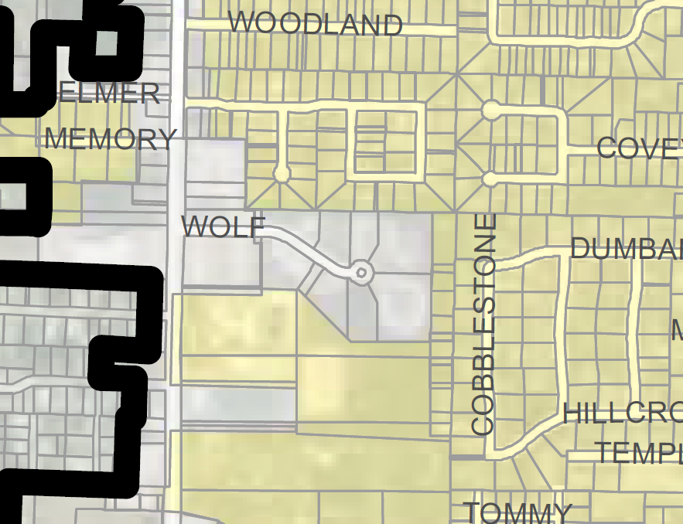
District E
Location of proposed zoning change
Current – Residential
Proposed – Mixed Use
NELSON
NELSON

Slide 25
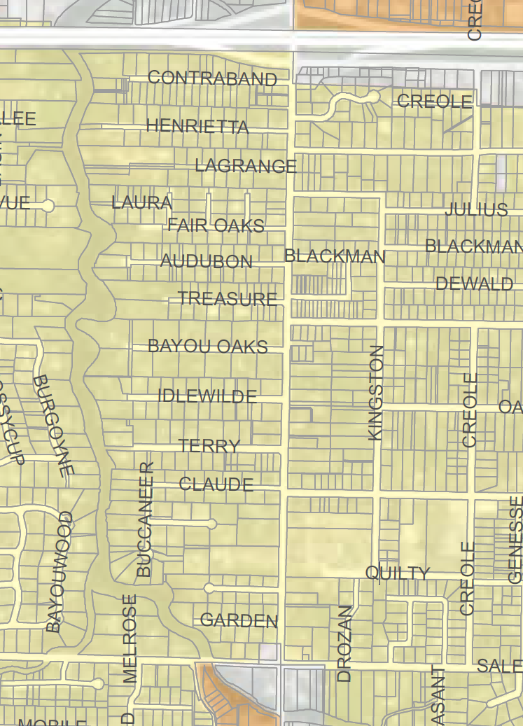
Current – Residential
District E
Will Remain Residential*
LAKE
LAKE
* At the City Council Meeting held on 1/3/2024, the Council voted to defer the rezoning for further review. However, they removed the proposed rezoning of this area from that consideration.

Slide 26
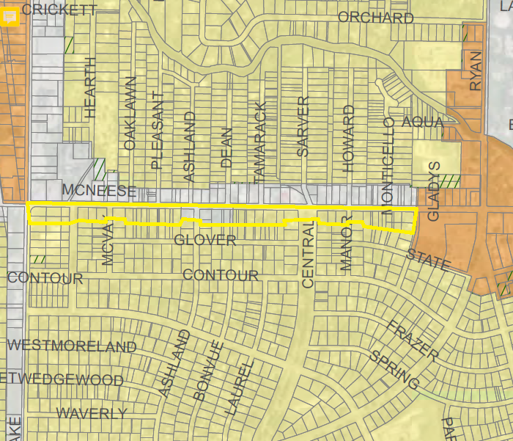
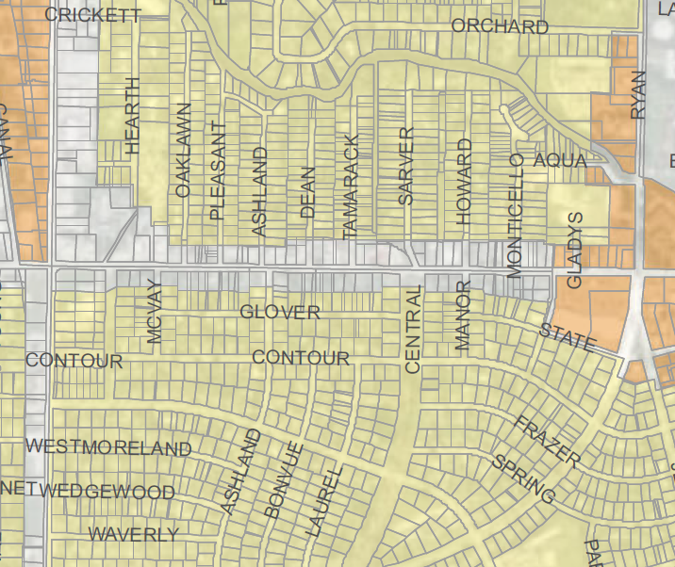
District E
Location of proposed zoning change
Current – Residential
Proposed – Mixed Use

Slide 27
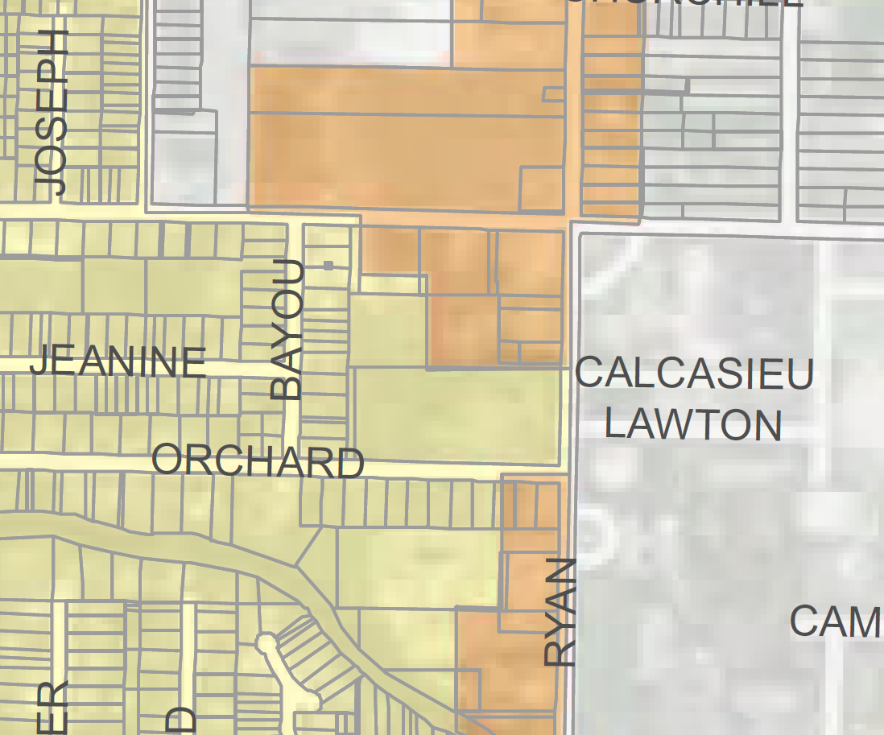
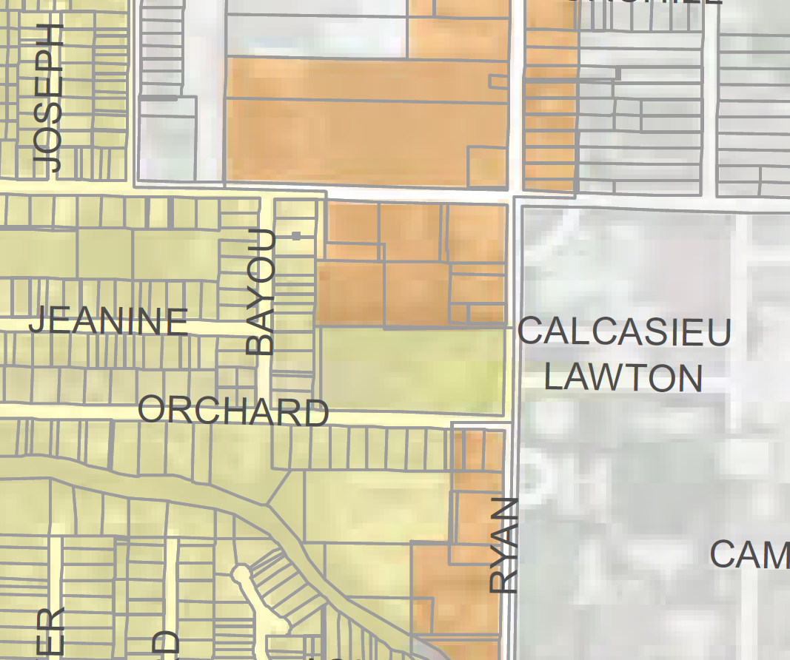
District E
Location of proposed zoning change
Current – Residential
Proposed – Business
SALE
SALE

Slide 28
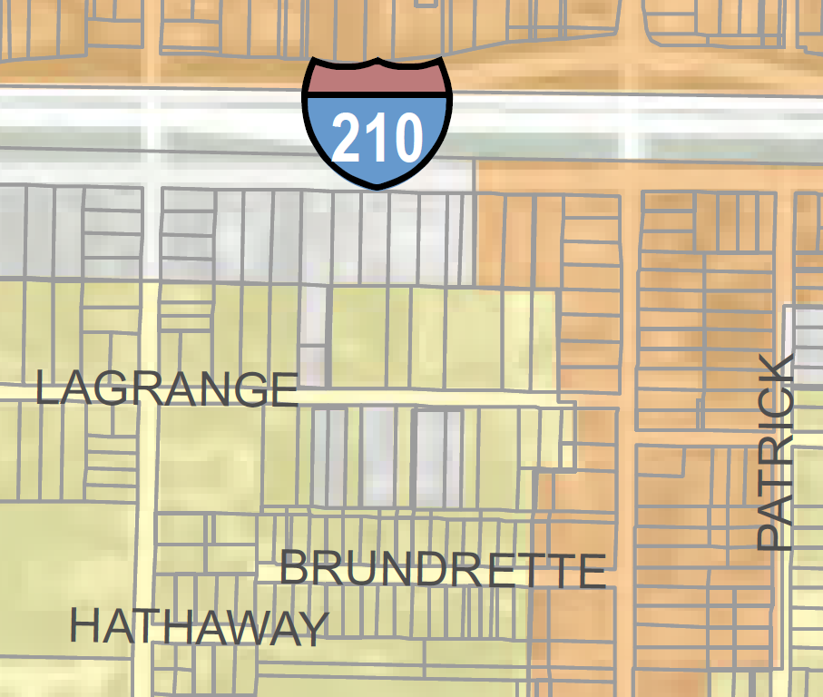
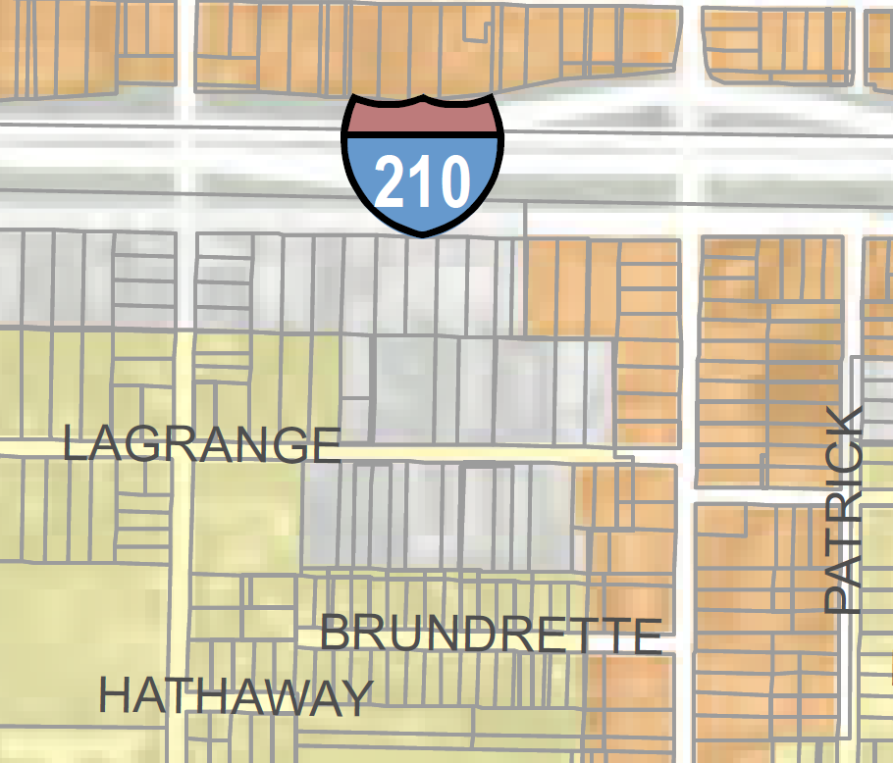
District E
Location of proposed zoning change
Current – Residential
Proposed – Mixed Use & Business
RYAN
RYAN

Slide 29
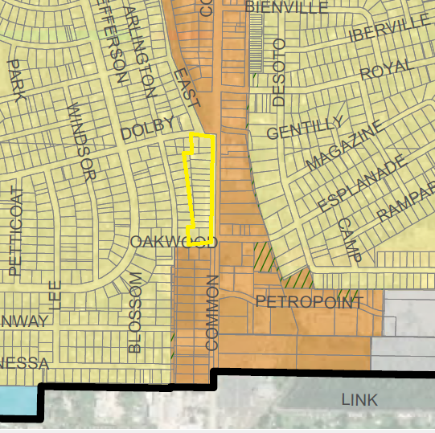
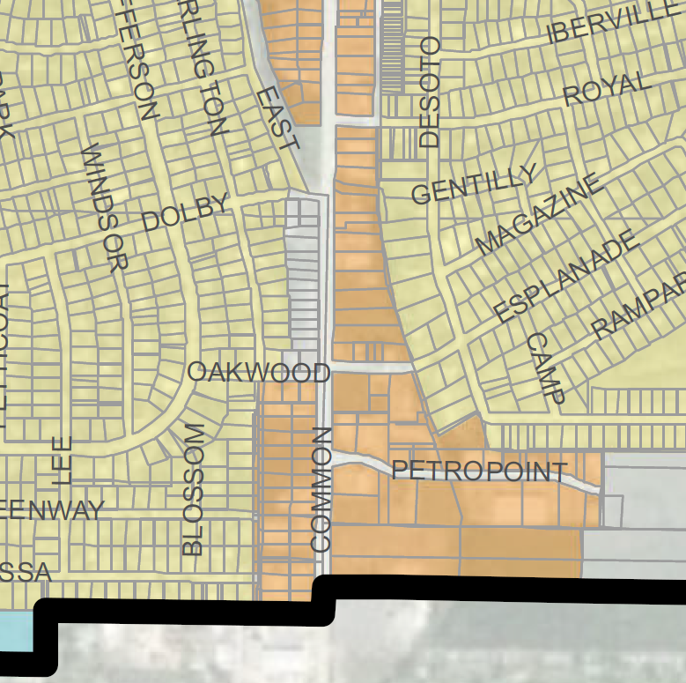
District F
Location of proposed zoning change
Current – Residential
Proposed – Mixed Use

Slide 30
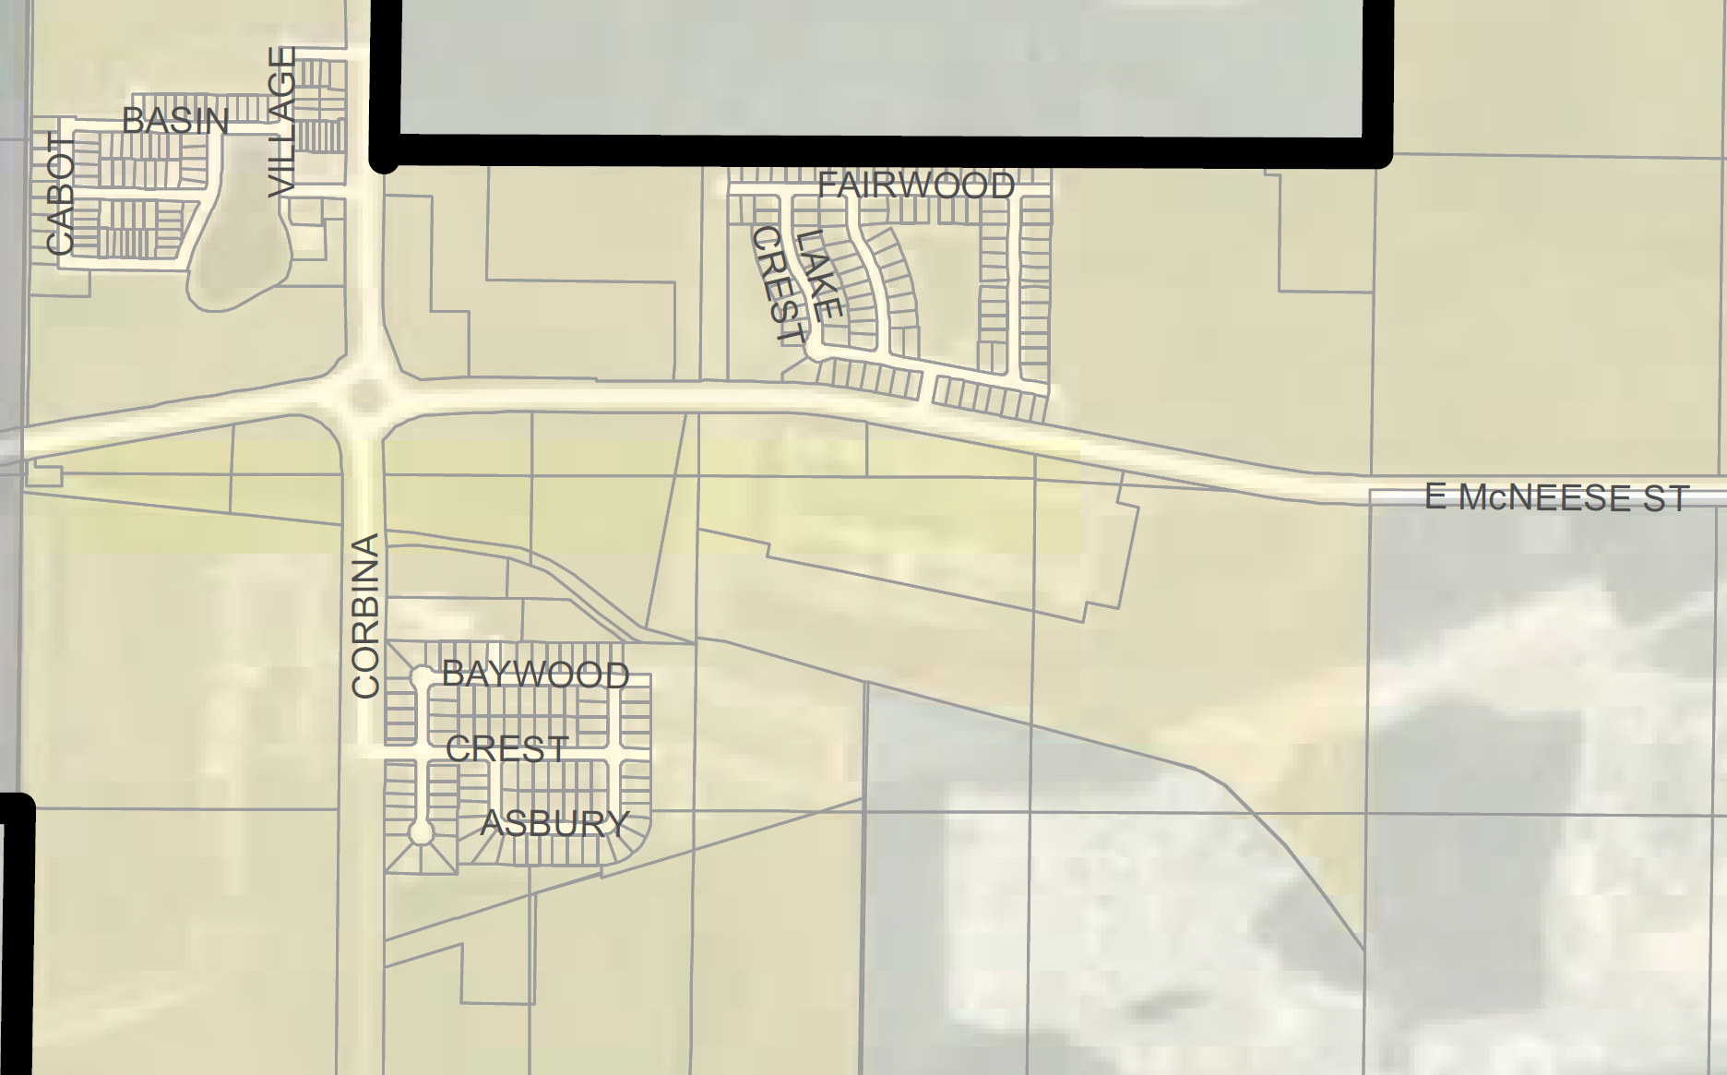
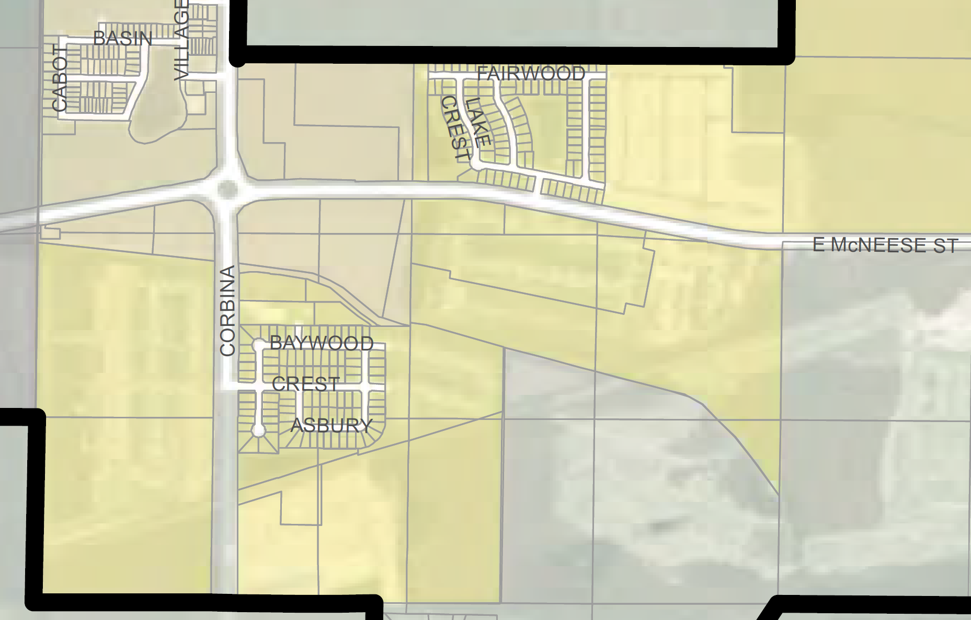
District F
Location of proposed zoning change
Current – TND
Proposed – Residential

Slide 31
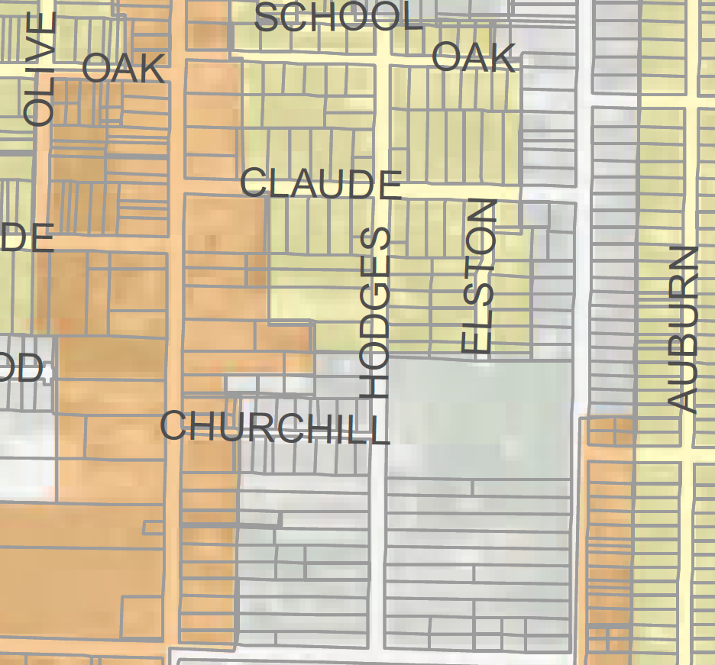
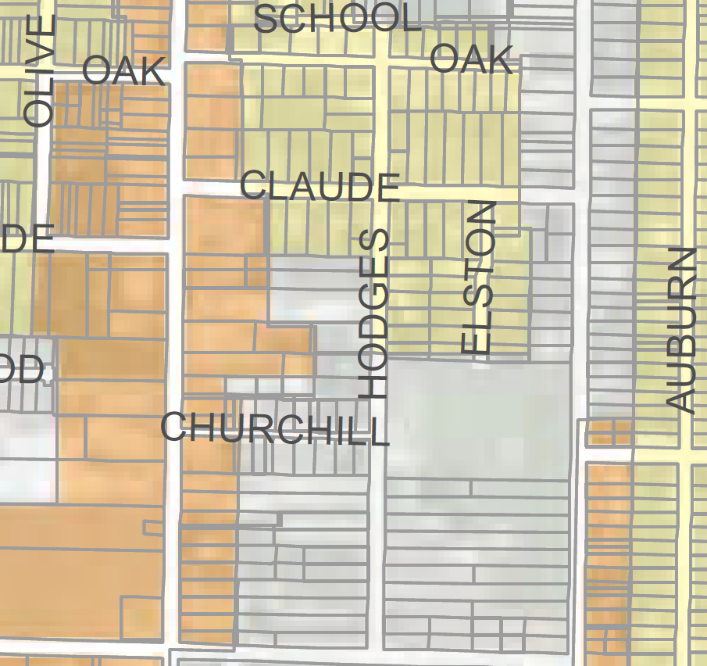
District F
Location of proposed zoning change
Current – Residential
Proposed – Mixed Use

Slide 32
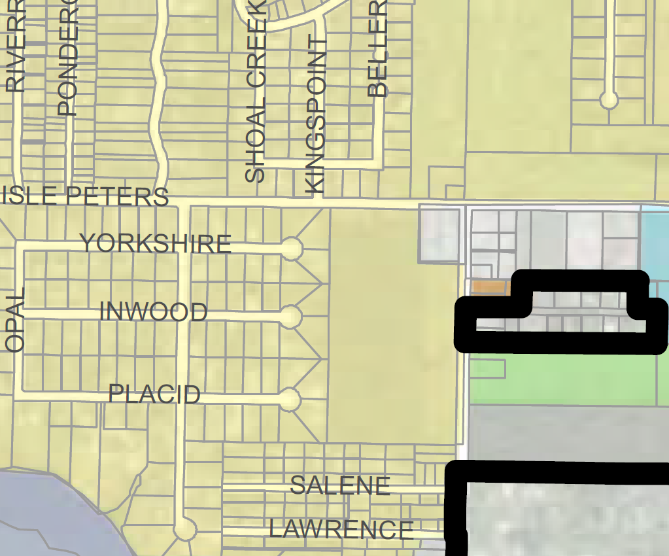
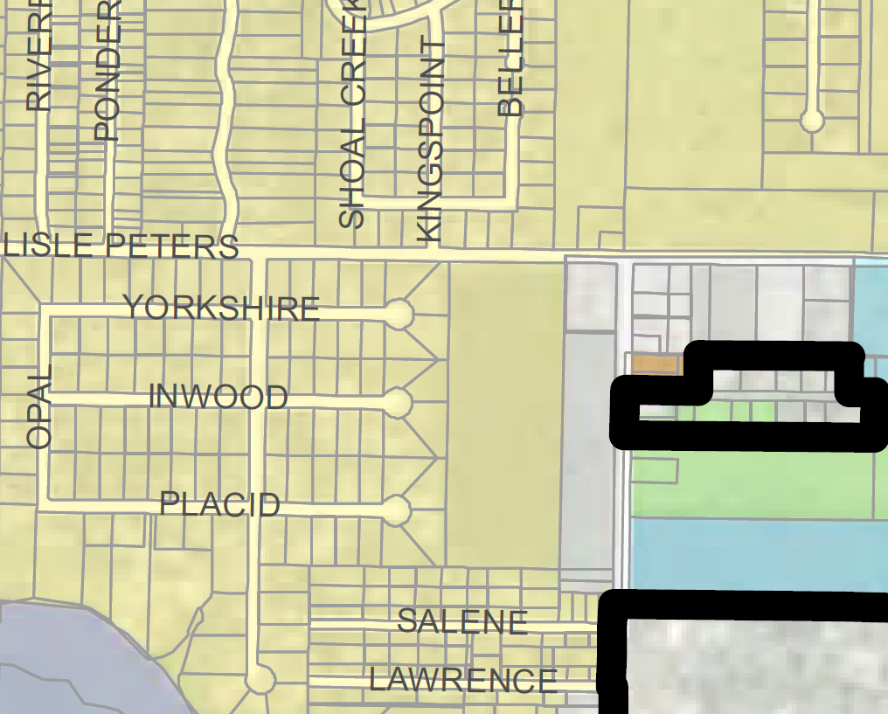
Location of proposed zoning change
District G
Current – Residential
Enterprise
Proposed – Mixed Use
BIG LAKE
Enterprise
BIG LAKE

Slide 33
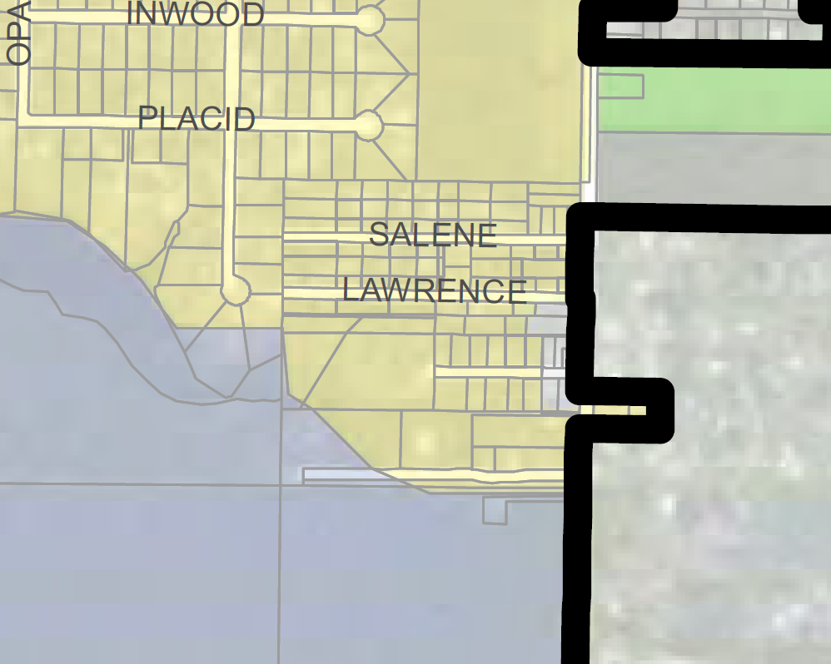
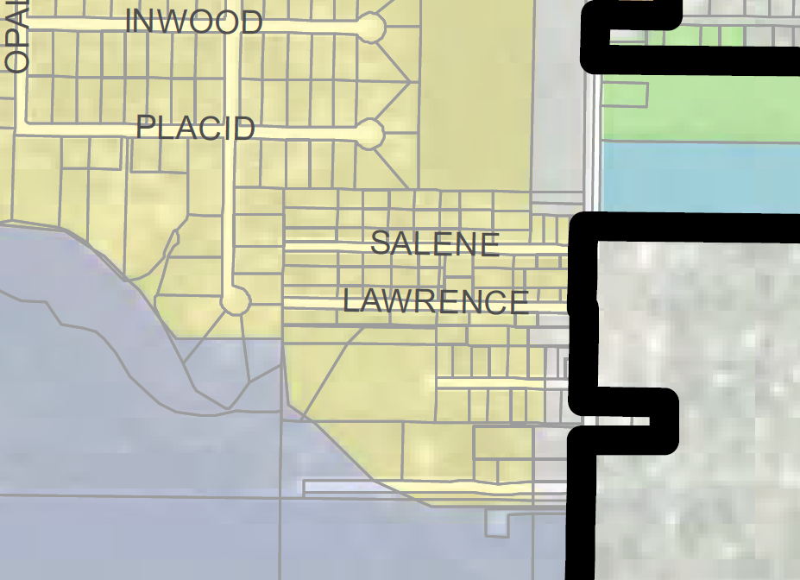
District G
Location of proposed zoning change
Current – Residential
BIG LAKE
Proposed – Mixed Use
BIG LAKE

Slide 34
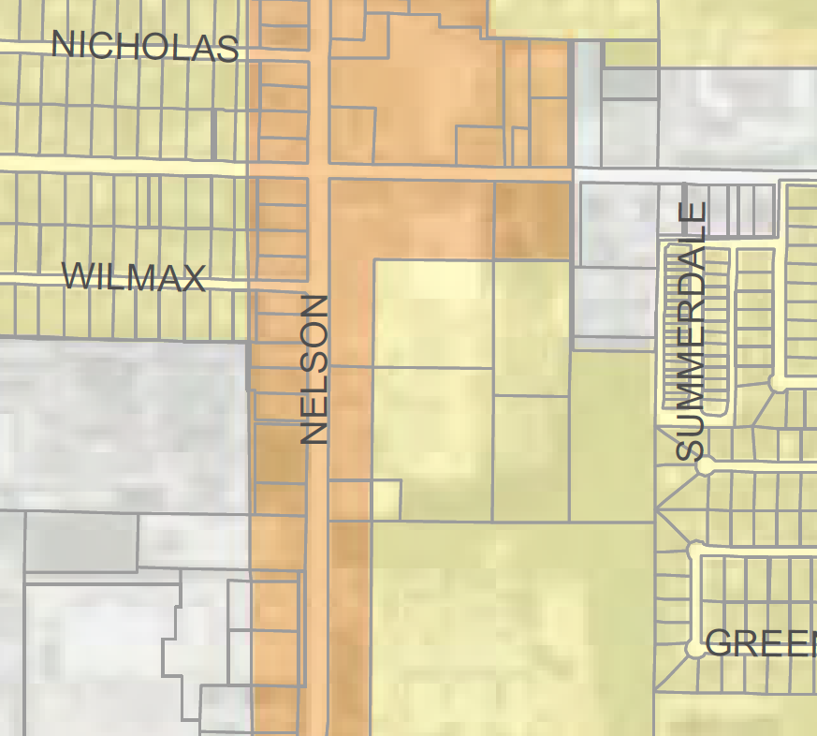
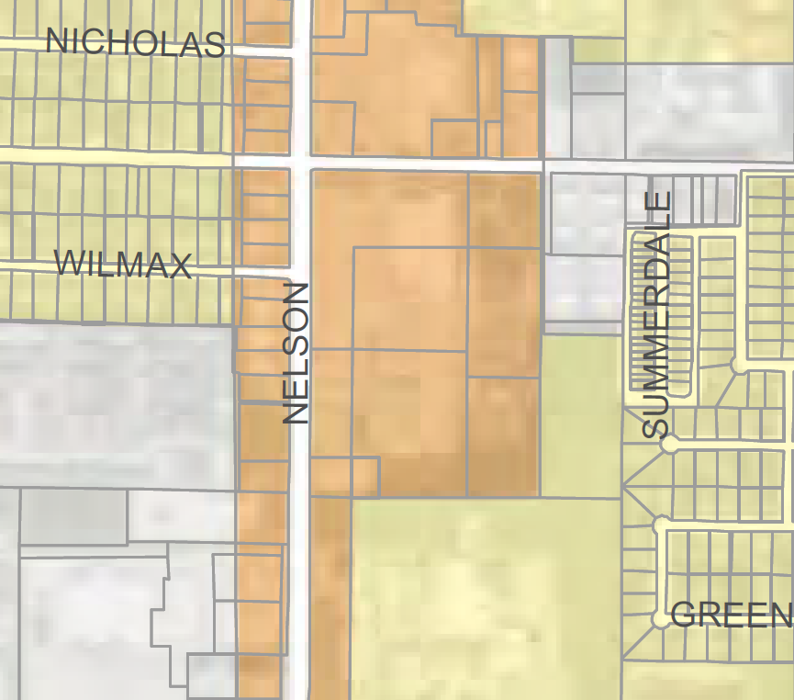
District G
Location of proposed zoning change
Current – Residential
Proposed – Business

Slide 35
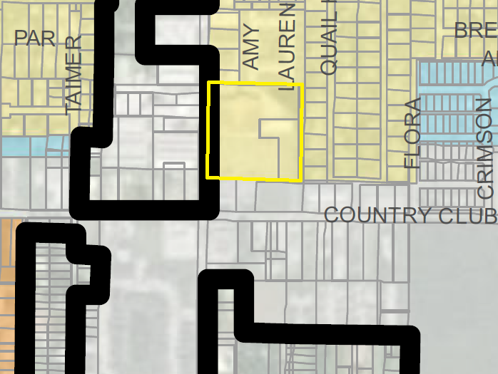
District G
Location of proposed zoning change
Current – Residential
Proposed – Business

Slide 36
District G
Location of proposed zoning change
Current – Light Manufacturing
Proposed – Mixed Use

Slide 37
District G
Location of proposed zoning change
Current – Light Manufacturing
Proposed – Mixed Use

Slide 38
District G
Location of proposed zoning change
Current – Residential
Proposed – Neighborhood

Slide 39
District G
Location of proposed zoning change
Current – Residential
Proposed – Neighborhood

Slide 40
Current Path Forward
City Council Amended in-part and deferred the proposed comprehensive rezoning plan.
For questions or more information, contact the City of Lake Charles Planning Department by calling (337) 491-1542.

